Slide 1
UMD DATA605 - Big Data Systems DevOps with Docker

Slide 2
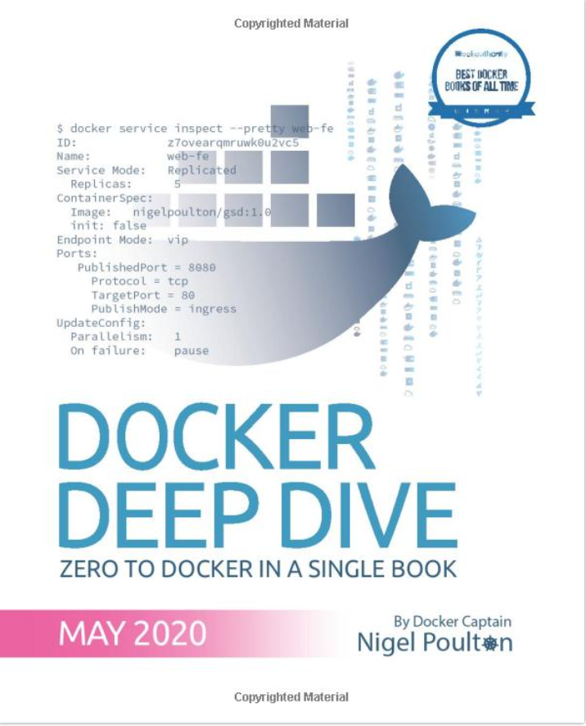
Docker - Resources
Concepts in the slides
Tutorial: tutorial_docker, tutorial_docker_compose
We will use Docker during the project
Web resources
A Beginner-Friendly Introduction to Containers, VMs and Docker
Official Docker Getting Started Tutorial
Mastery:
Poulton, Docker Deep Dive: Zero to Docker in a single book, 2020
Google SRE book TODO

Slide 3
Application Deployment
For (almost all) Internet companies, the application is the business
If the application breaks, the business stops working
E.g., Amazon, Google, Facebook, on-line banks, travel sites (e.g., Expedia)
Problem:
How to release / manage / deploy / monitor applications?
Solutions:
Before 2000s: “bare-metal era”
2000s-2010s: “virtual machine era”
> ~2013: “container era”

Slide 4
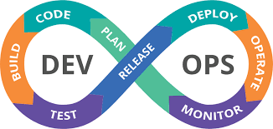
DevOps
DevOps = set of practices that combines software development (dev) and IT operations (ops)
Container technology revolutionized DevOps
Enable true independence between applications and IT ops
Teams create applications
Teams deploy and manage applications
Create a model for better collaboration (fewer conflicts) and innovation
IT: “It doesn’t work!”
Devs: “What? It works for me”

Slide 5
Before Virtualization
< 2000s
“Run on the bare metal”
Running one or few applications on each server
Pros:
No virtualization overhead
Cons:
Not safe / not secure
Expensive
IT would buy a new server for each application
Difficult to spec out the machine -> buy “big and fast servers”
Overpowered servers operating at 5-10% of capacity
Tons of money in the 2000 DotCom boom was spent on machines (Sun Servers) and networks (Cisco)

Slide 6
Virtual Machine Era
Circa 2000-2010
Virtual machine technology = run multiple copies of OSes on the same hardware
Pros:
VM ran safely and securely multiple applications on a single server
IT could run apps on existing servers with spare capacity
Cons:
Every VM requires an OS (waste of CPU, RAM, and disk)
Monitor and patch each OS
Buy an OS license
VMs are slow to boot

Slide 7
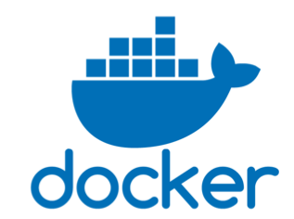
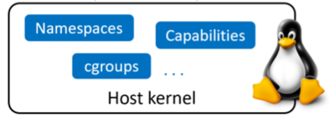
Containers Era
Circa 2013: Docker becomes ubiquitous
Pros:
Containers don’t require full-blown OS
All containers run on a single host
Reduce OS licencing cost
Reduce overhead of OS patching and maintenance
Containers are fast and portable
Cons:
CPU overhead
Toolchain to learn / use
Docker
Didn’t invent containers
Made containers simple and mainstream
Linux supported containers for some time
Kernel namespaces
Control groups
Union filesystems

Slide 8
Serverless Computing
Containers run in an OS which runs on a host
Where is the host
Local (your laptop)
On premise (your own computers in a rack)
Cloud instance (e.g., EC2)
What is the host
Bare-metal server
On a virtual machine
On a virtual machine running a virtual machine
Serverless computing
As long your application runs somewhere, you don’t care “how” or “where”

Slide 9
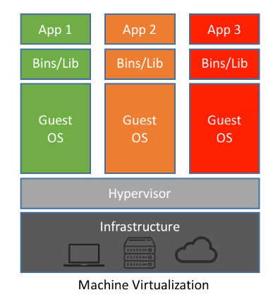
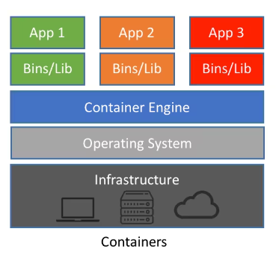
OS vs Container Virtualization
Hypervisor boots and performs HW virtualization
Carves out physical hardware resources into VMs
Resources (CPUs, RAM, storage) are allocated to a VM
“Virtual machine tax”
To run 3 apps, need 3 VMs and 3 OSes
Each VM requires time to start
Consume CPU, RAM, storage
Need a license
Need admins
Containers
Docker performs OS virtualization

Slide 10
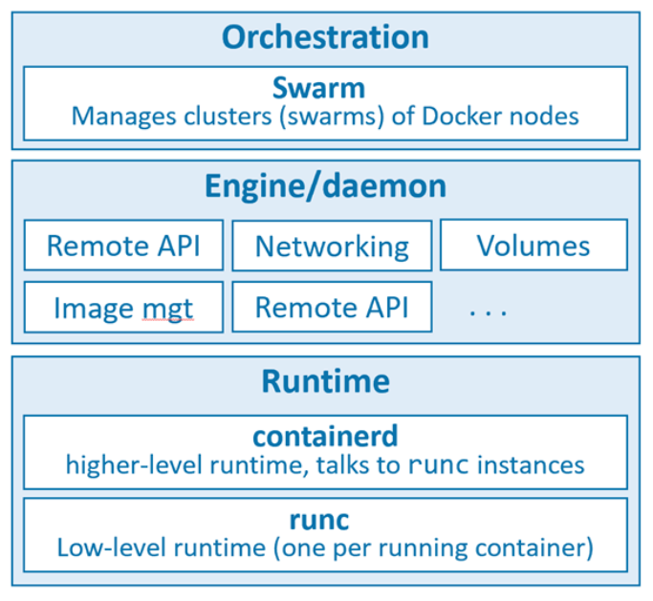
Docker Architecture
Docker run-time
runc: start and stop containers
containerd:
Pull images
Create volumes, network interfaces
Docker engine
dockerd:
Expose remote API
Manage images, volumes, networks
Docker orchestration
docker swarm
Manage clusters of nodes
Replaced by Kubernetes
Open Container Initiative (OCI)
Standardize low-level components of container infrastructure
E.g., image format, run-time API
“Death” of Docker

Slide 11
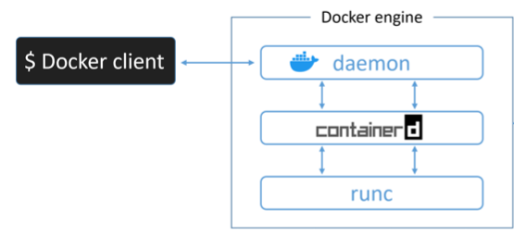
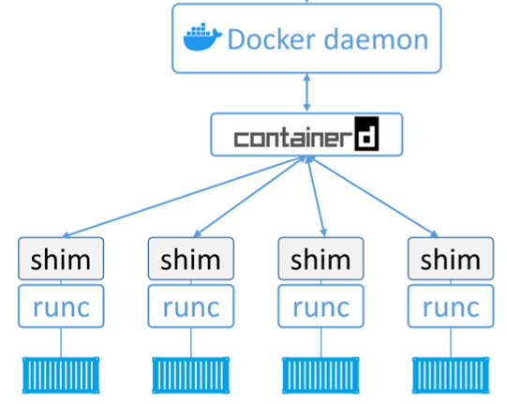
Docker: Server-Client
Server-client architecture
Docker client
Command line interface
Communicate with the server through IPC socket (e.g., /var/run/docker.sock) or IP port
Docker engine
Run and manage containers
Modular and built from several OCI-compliant sub-systems
E.g., Docker daemon, containerd, runc, plug-ins for networking and storage

Slide 12
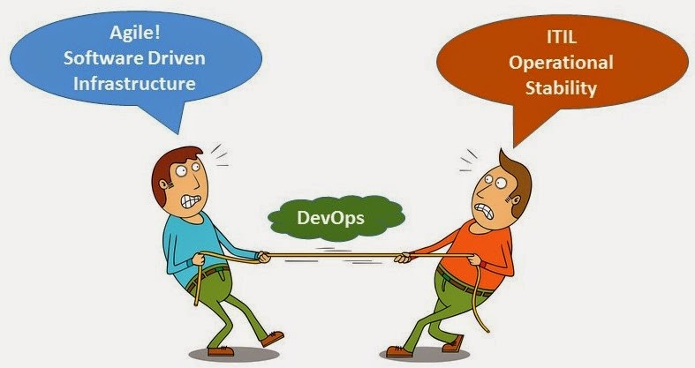
Devops = Devs + Ops
Devs
Implement the app (e.g., Python, virtual env)
Containerize the app
Create Dockerfile
Contain the instruction on how to build an image
Build image
Run the app as a container
Test “locally”
Ops
Download images
Contain filesystem, application, app dependencies
Start containers
Destroy container
In case of issues, it’s easy to repro the problem
Here is the log
Run command line
Deploy on a test system and debug

Slide 13
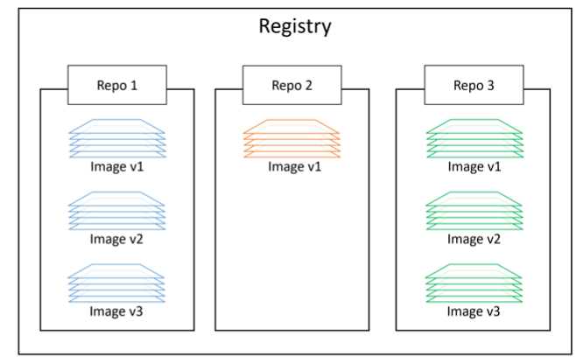
Docker Containers
Docker Containers
Lightweight, stand-alone, executable software package
Includes everything needed to run
E.g., code, runtime / system libraries, settings
Run-time objects
vs Docker images are built-time objects
Docker repos
Store Docker images
<registry>/<repo>:<tag>
alpine:latest
E.g., DockerHub, AWS ECR
Some repos are vetted by Docker
Unofficial repos shouldn’t be trusted

Slide 14
Docker Image
Unit of deployment
Contain everything needed by an application to run
Application code
Application dependencies
Minimal OS support
Can build images from Dockerfiles
Can pull pre-built image s from registry
Multiple layers stacked on top of each other
Typically few 100s MBs

Slide 15
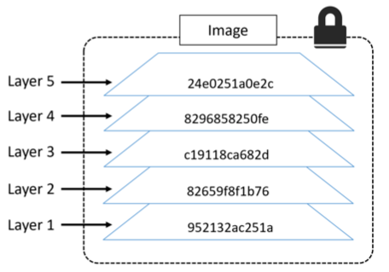
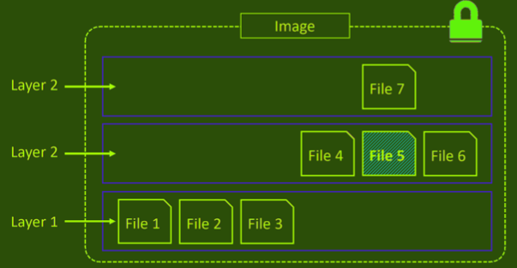
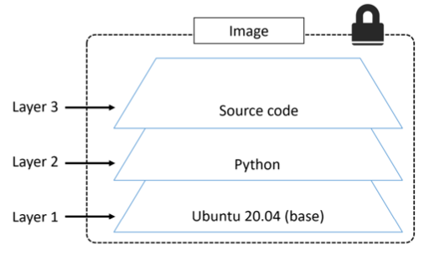
Docker Image Layers
A docker image is a configuration file that lists the layers and some metadata
It is composed of read-only layers
Each layer comprising of many files
Each layer is independent from each other
Docker driver
Stacks these layers representing them as a unified filesystem
Files from the top layers can obscure the files from the bottom layers
Implements a copy-on-write behavior
Layer hash
Each layer has an hash based on its content
Layers are pulled and pushed compressed the hash of a compressed layer is different
A "distribution hash" is used
Image hash
Each image has an hash
The hash is function of the config file and of the layers
When an image changes, a new hash is generated

Slide 16
Docker: Container Data
Container storage is ephemeral
Data inside of containers is persisted as long as the container is not killed
If you stop or pause a container data is not lost
Containers are designed to be immutable
It's not good practice to write “persistent” data into containers
Bind-mount
Bind-mounting a local dir
A local dir is mounted to a dir inside a container
Docker volumes
E.g., to store the content of a Postgres DB
Docker provides volumes that exist separately from the container
State is permanent across container invocations
Can be shared across containers

Slide 17
Containerizing an App
Develop your application code using the needed dependencies
Install dependencies
Directly inside a container
Inside a virtual env
Create a Dockerfile describing:
your app
its dependencies
how to run it
Build image with `docker image build`
(Optional) Push image to a Docker image registry
Run container from image

Slide 18
Building a Container
Dockerfile
Describe how to create a container
Build context
> docker build -t web:latest .
Sent to Docker engine to build the application
Directory containing the application and its dependencies
Typically the Dockerfile is in the root directory of the build context

Slide 19
Dockerfile Example
FROM python:3.8-slim-buster
LABEL maintainer="gsaggese@umd.edu"
WORKDIR /app
COPY requirements.txt requirements.txt
RUN pip3 install -r requirements.txt
COPY . .
CMD ["python3","-m", "flask", "run", "--host=0.0.0.0"]

Slide 20
Docker Tutorial
tutorial_docker.md

Slide 21
Docker Compose
Deploy and manage multi-container applications running on a single node
Describe the app in a single declarative configuration YAML file
Instead of scripts with long Docker commands
Compose talks to Docker API to achieve what you requested
E.g., you need a client app and Postgres DB
E.g., microservices
Web front-end
Ordering
Back-end DB
In 2020 Docker Compose has become an open standard for “code-to-cloud” process
To run on multiple hosts
Docker Stacks / Swarm
Kubernetes

Slide 22
Docker Compose: Commands
> docker compose --help
Usage: docker compose [OPTIONS] COMMAND
Options:
--env-file string Specify an alternate environment file.
-f, --file stringArray Compose configuration files
-p, --project-name string Project name
Commands:
build Build or rebuild services
convert Converts the compose file to platform's canonical format
cp Copy files/folders between a service container and the local filesystem
create Creates containers for a service.
down Stop and remove containers, networks
events Receive real time events from containers.
exec Execute a command in a running container.
images List images used by the created containers
kill Force stop service containers.
logs View output from containers
ls List running compose projects
pause Pause services
port Print the public port for a port binding.
ps List containers
pull Pull service images
push Push service images
restart Restart containers
rm Removes stopped service containers
run Run a one-off command on a service.
start Start services
stop Stop services
top Display the running processes
unpause Unpause services
up Create and start containers
version Show the Docker Compose version information

Slide 23
Docker Compose: Tutorial Example
The default name for a Compose file is `docker-compose.yml`
You can specify `-f` for custom filenames
Top-level keys are:
`version`:
Mandatory first line to specify API version
Ideally always use the latest version
Typically 3 or higher
`services`:
Define the different microservices
`networks`:
Creates new networks
By default it creates a `bridge` network to connect multiple containers on the same Docker host
`volumes`:
Creates new volumes
Key in services describe a different “service” in terms of container
Inner keys specify the params of Docker run command
version: "3.8"
services:
web-fe:
build: .
command: python app.py
ports:
- target: 5000
published: 5000
networks:
- counter-net
volumes:
- type: volume
source: counter-vol
target: /code
redis:
image: "redis:alpine"
networks:
counter-net:
networks:
counter-net:
volumes:
counter-vol:

Slide 24
Docker Compose: Tutorial
Example taken from https://github.com/nigelpoulton/counter-app
tutorial_docker_compose
> cd tutorials/tutorial_docker_compose
> vi tutorial_docker_compose.md

